Slide 1


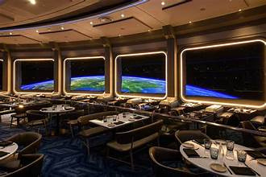




DISNEY RESTAURANT
DATABASE
By Emily Brown and Erin McNulty

Slide 2

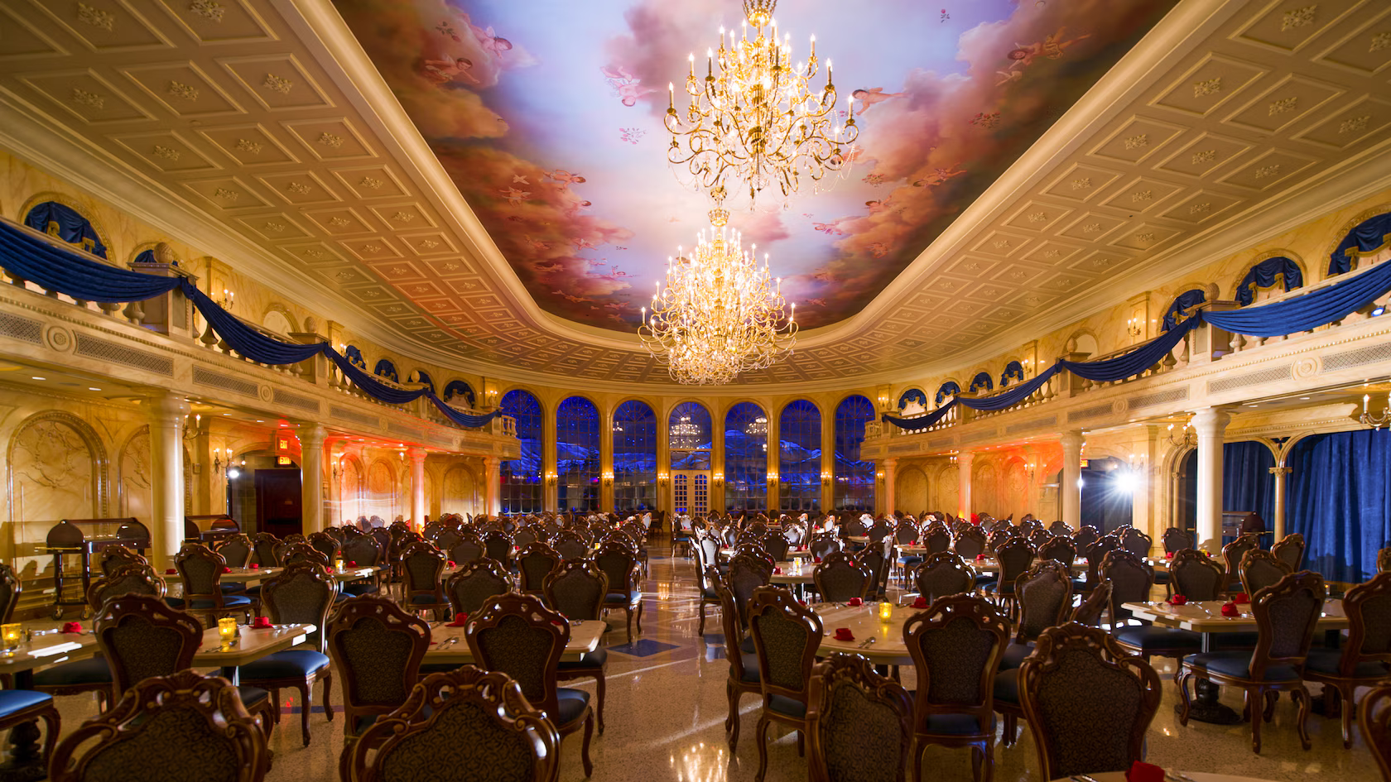

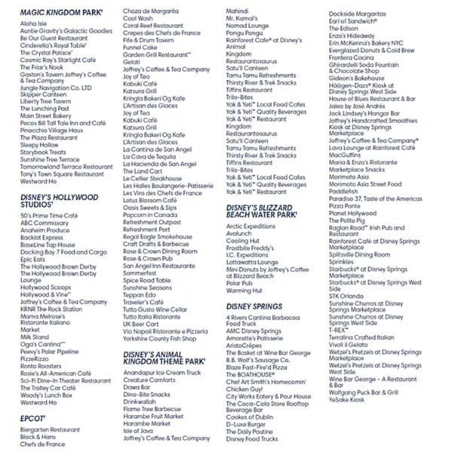
THE ISSUE
400 RESTAURANTS
TOO MANY CHOICES
100 WITH RESERVATIONS
MULTIPLE
DINING
TYPES
6 PARKS
26 HOTELS
1 SHOPPING DISTRICT

Slide 3


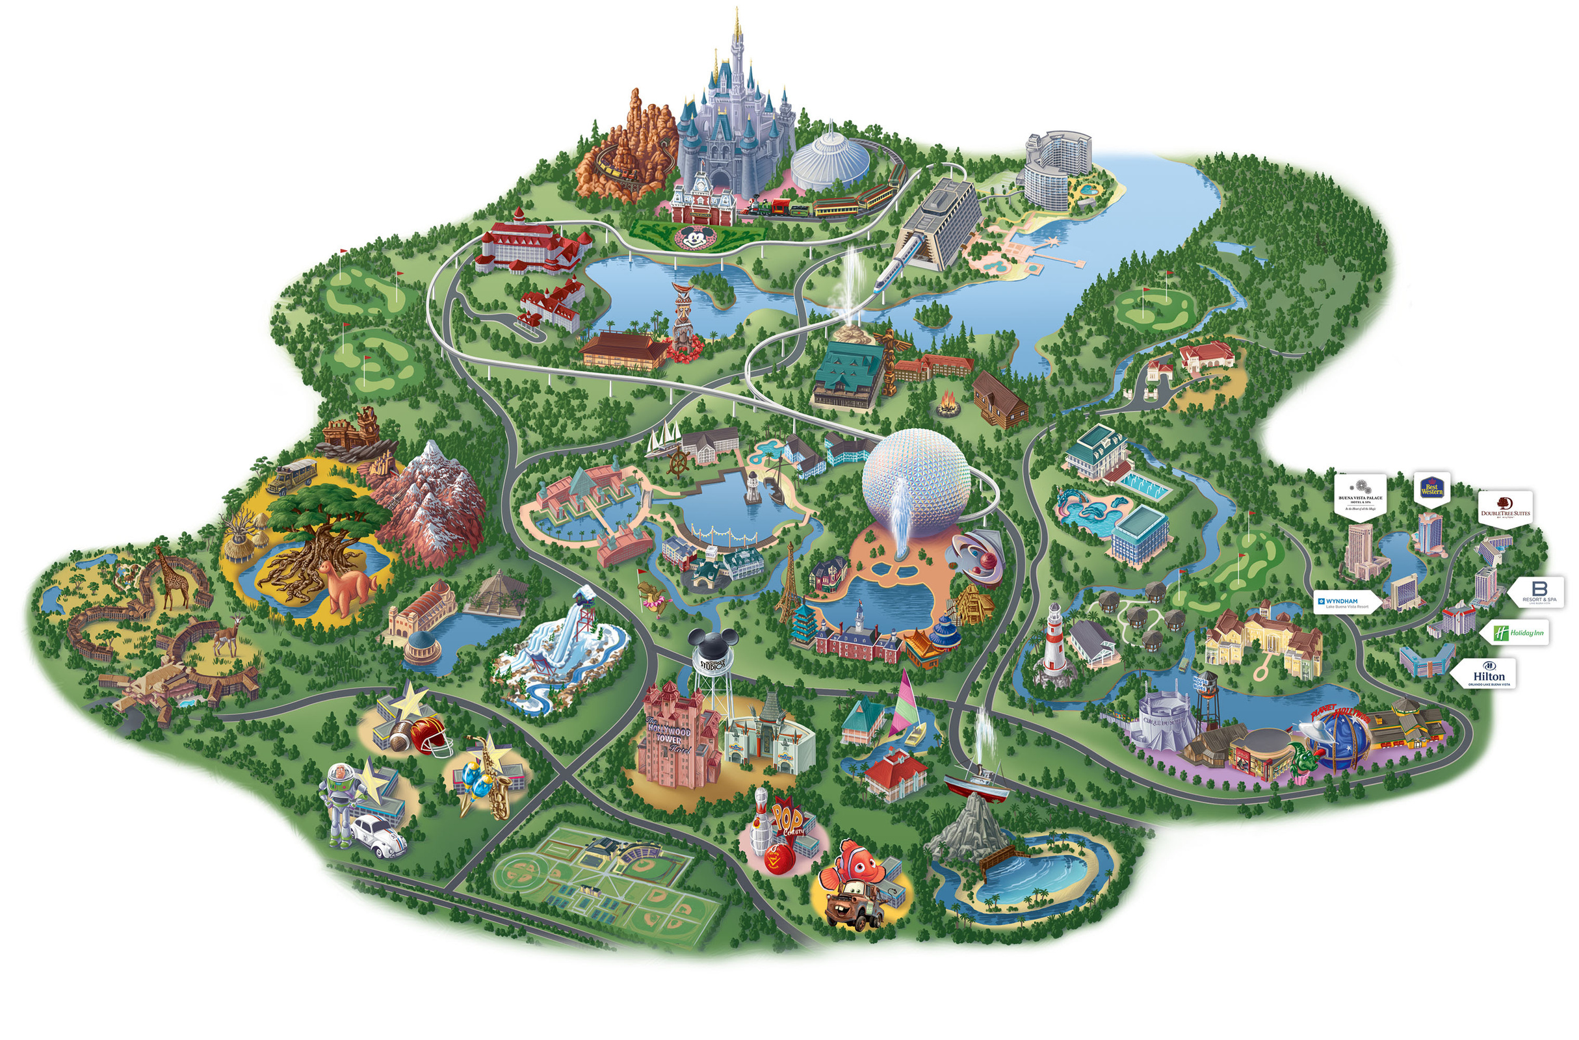

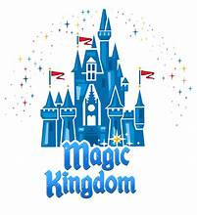
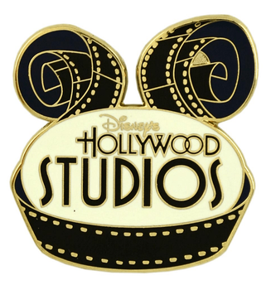
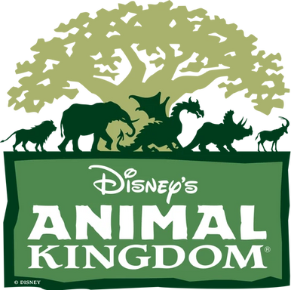
SEARCH BY PARK
NULL

Slide 4
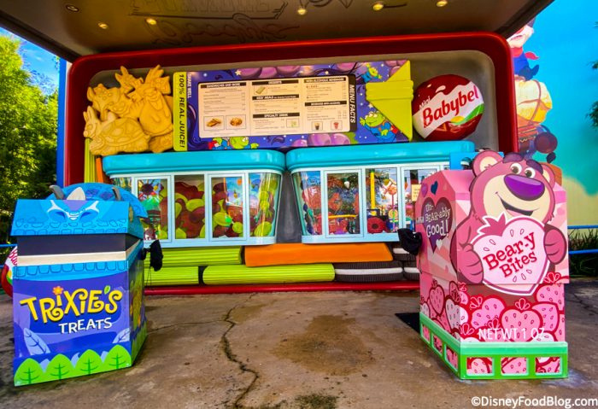
SEARCH BY SERVICE TYPE
Quick Service Or
Reservations needed

Slide 5

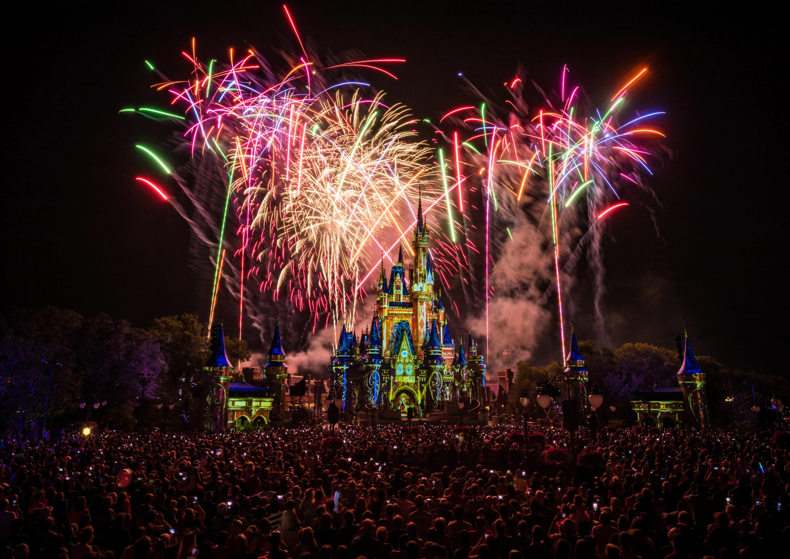






ADD FAVORITES
REMOVE FAVORITES
EXPORT FAVORITES

